Slide 1
Chapter 9 Sound in medicine
Dr rafid albadr |

Slide 2
General Properties of Sound
Sound waves require a medium for their transmission. Matter (air, liquids, solids) must be present for sound to travel. Unlike light (EM wave) which travel through matter free space.
Sound represents a longitudinal wave of wavelength $λ$ and frequency $f$ which is transmitted by pressure (density) change with the speed of sound $v$ in transmitting medium.
$$v =λ. f$$
Speed of sound is a material constant (depends on molecular structure, temperature, and density of material), therefore product of wavelength and frequency is constant.
The higher the density, the higher is the velocity of the sound.
For example for a sound wave with a frequency of 1000Hz, υ = 344 m/sec in air at 20ºC and λ= 0.344m.
$$v =\left(311+0.606T_{c}\right)\left[\frac{m}{s}\right]$$

Slide 3
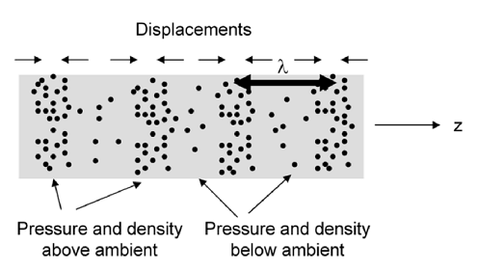
General Properties of Sound

Slide 4
General Properties of Sound
Below audible range: infrasound
Human sound system operates within a certain frequency range:
Range of human voice: 64 Hz (male bass) to 2050 Hz (2.05 kHz) (female soprano)
Range of human ear: 20 Hz to 20000 Hz (20 kHz)
Frequencies above audible range: ultrasound
the velocity of ultrasound in bone is twice that in soft tissue and the velocity in soft tissue is five times that in air. The velocity of ultrasound does not depend on frequency, it is determined by the medium

Slide 5
Intensity of Sound Waves
The intensity (I) of a sound wave is the energy carried by the wave per unit area and per unit time (in units of J/m²-s or W/m²).
The capability of hearing does not depend on the frequency of sound but also on the intensity.
At a distance R from an isotropic source of average acoustic power, the intensity is
$$I=\frac{P_{power}}{4πR^{2}}$$
$$I=\frac{E}{t .area} \left[\frac{J}{s.m^{2}}\right]=\left[\frac{W}{m^{2}}\right]$$

Slide 6
Intensity of Sound Waves
The total intensity can be expressed in terms of density ρ
$$I= \frac{1}{2} ρ v A^{2} {(2π f)}^{2} [\frac{W}{m^{2}}]$$
Where ρ the density of medium υ is the velocity of sound; f is the frequency; w is the angular frequency which equals 2πf , A is the maximum displacement amplitude of the atoms or molecules.
An intensity of I_{ο}= 10⁻¹² W/m² is about the lowest intensity sound wave that can be hear

Slide 7
Acoustic Impedance
The acoustic impedance of a medium Z is given by the product of the mass density and sound speed for that medium
Acoustic impedance (Z) is used to describe the reflection of sound at an interface.
mathematically, acoustic impedance is described by:
$$Z=v ρ$$
$ρ$ : is the density of the medium (Kg/m3), $v$ : is the velocity of the sound in the medium (m/ s)

Slide 8
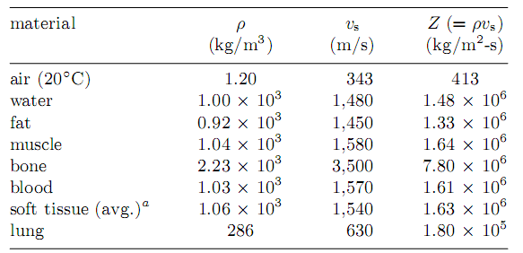
Acoustic Impedance

Slide 9
Intensity of Sound Waves
The acoustic intensity is
$$I=\frac{P^{2}}{2Z}$$
ΔP = (P −P_{atmosphere}) as P for the rest of this chapter and call it the sound pressure.
We can present the sound intensity I in units of W/m² or any other equivalent units.
which I is referenced to I_{ref} = 10⁻¹² W/m²; I_{ref} is a sound intensity that is barely audible at 3,000 Hz.

Slide 10
Intensity of Sound Waves
International standard unit corresponding to an intensity ratio of 10 :
I (in bels) = log10(I/I_{ref} ).
In units of bels, named after Alexander Graham Bell,
standard to use a finer scale in tenths of bells, called decibels or dB
$$I\left(in dB\right)=10 log\frac{I}{I_{ref}}$$
For example, for I = 10⁻⁸ W/m² = 10⁴ I_{ref} we see that I(in dB) =10 log10(10⁴) = 10 × 4 = 40, or 40 dB

Slide 11
Intensity of Sound Waves
As shown before, sound intensity is directly related to pressure change:
$$I ∝ P^{2}$$
$$1db = 10 . \log_{10}\frac{I_{2}}{I_{1}}= 1db = 10 . \log_{10}{(\frac{P_{2}}{P_{1}})}^{2}=20 . \log_{10}\frac{P_{2}}{P_{1}}$$
When the sound intensity increases by 60 dB, I increases by 10⁶ and P increases by 10³.

